Slide 1
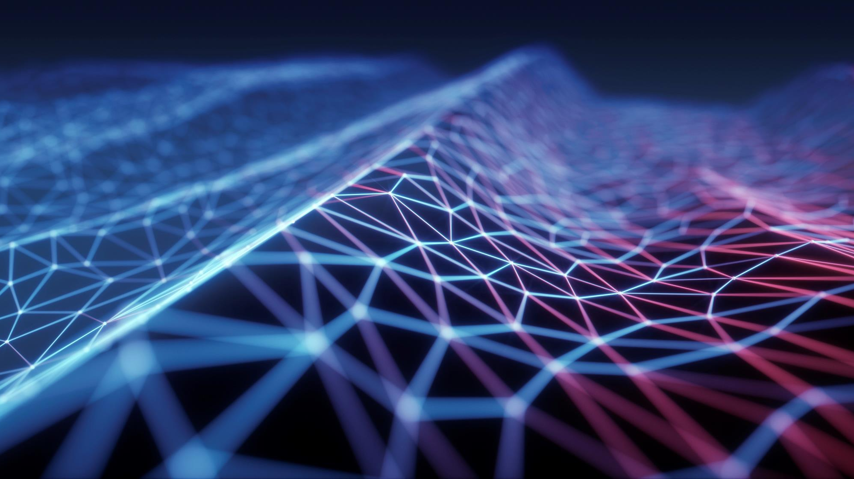
Spam email detection (ML101)
CN162 - LunaticZs

Slide 2
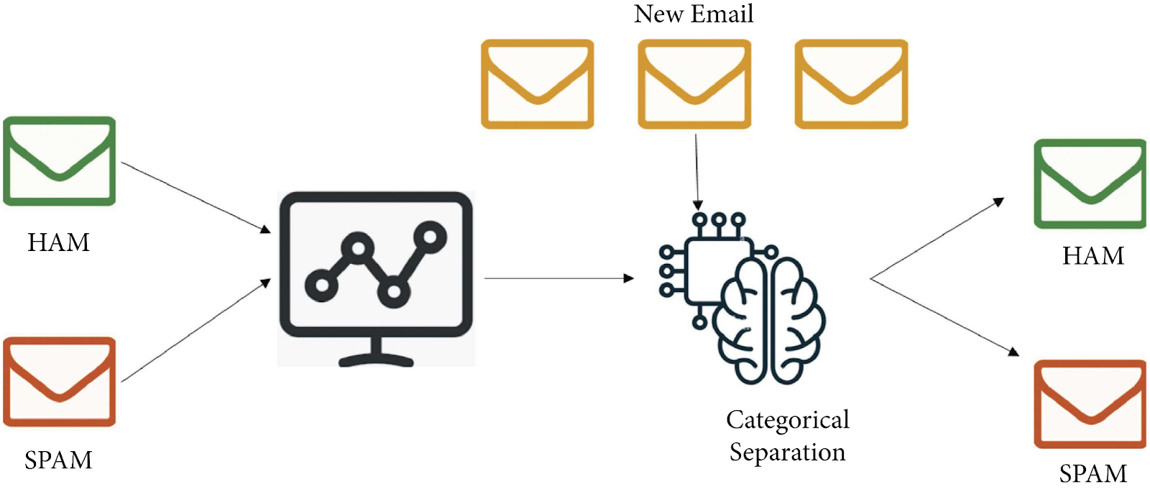


Work flow
Emails
Trained Model
Link
Person’s PC
Spam Email Detector Model

Slide 3
INTRODUCTION
In the digital age, where communication is largely facilitated through electronic means, the prevalence of spam mail has become a significant challenge. Spam mail, also known as junk mail or unsolicited bulk email, inundates email inboxes with unwanted and often malicious content, ranging from advertisements and scams to phishing attempts and malware distribution. Not only does spam mail consume valuable storage space and bandwidth, but it also poses serious security threats to individuals, businesses, and organizations worldwide.

Slide 4

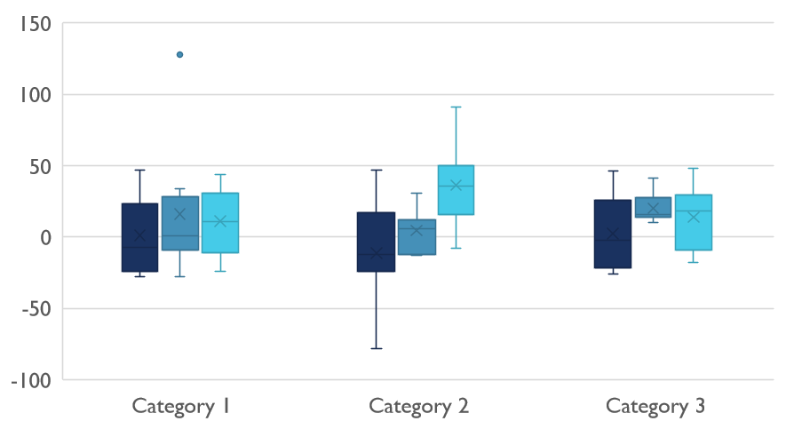
Competitive Landscape

Slide 5

Digital Communications
Cloud
Local
Hybrid

Slide 6
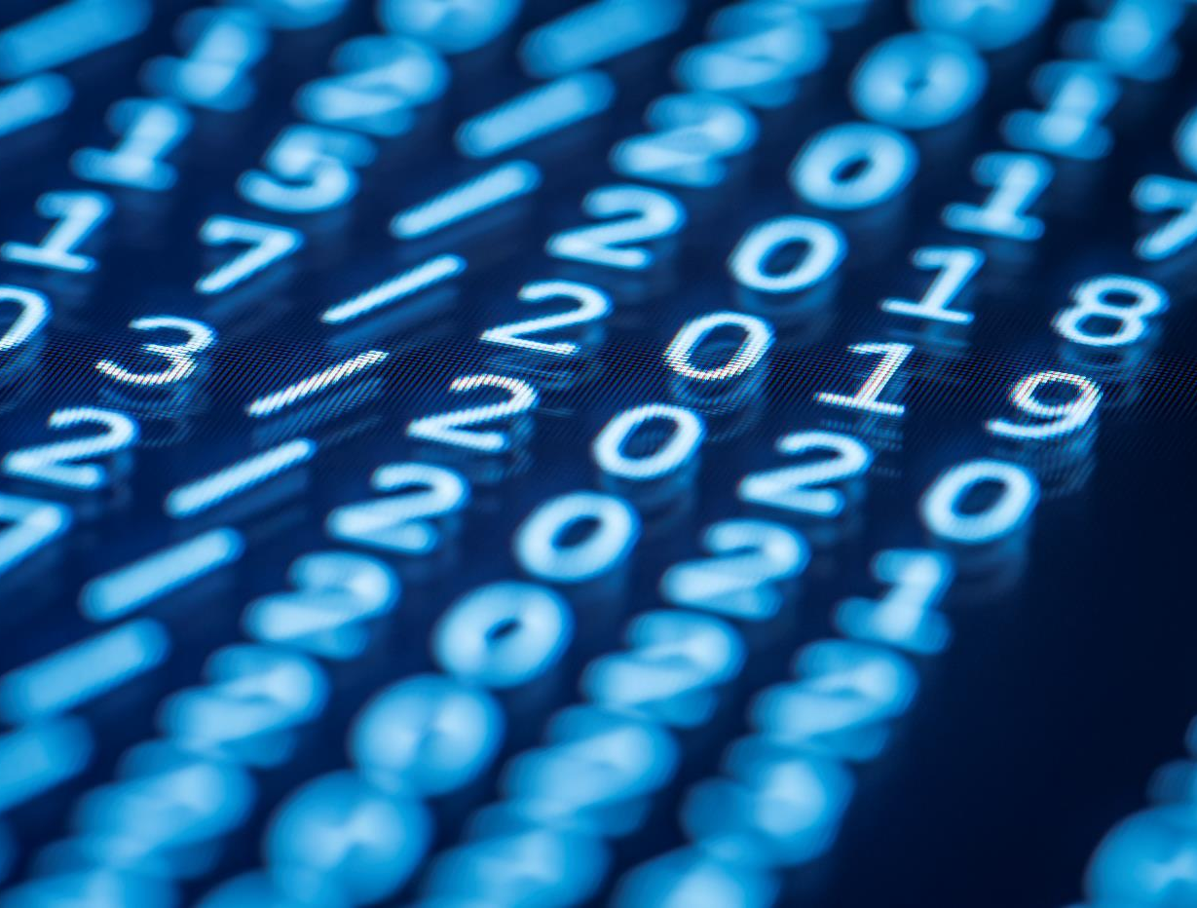
Thank You
someone@example.com

